Slide 1
Wordpress 8 Training
Koushik G
9740294141
koushikgraj@gmail.com

Slide 2
What is a website?
A website is a collection of related material that contains text, images, and may also include video, audio or other media. These contents will be accessible world wide.
Why is a website?
A website is your most powerful tool for communication.
A website is a unique way to connect with the world. Whether you choose to create a website to share & inform people of your business, sell products, or any other reason there are no boundaries to what you can do! With a website, tons of possibilities are available to you!

Slide 3



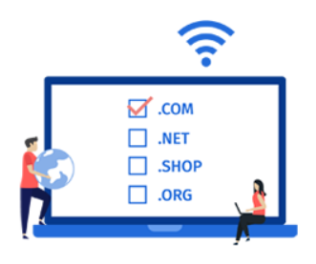

Requirements to create a website
Domain Name
Web hosting server
Business Emails
Content to display in website
Website Designer/Developer

Slide 4




How much dose cost to build a website?
Cost Component | Cost
Domain Name | ₹ 500/year
Hosting | ₹ 2400/year
Business Email | ₹ 350/year
Cost Component | Cost
Domain Name | ₹ 800/year
Hosting | ₹ 3000/year
Business Email | Free
Cost Component | Cost
Domain Name | Free(one year)
Hosting | ₹ 2100/year
Business Email | ₹ 1500/year
Cost Component | Cost
Domain Name | ₹ 715/year
Hosting | ₹ 549/year
Business Email | Free

Slide 5
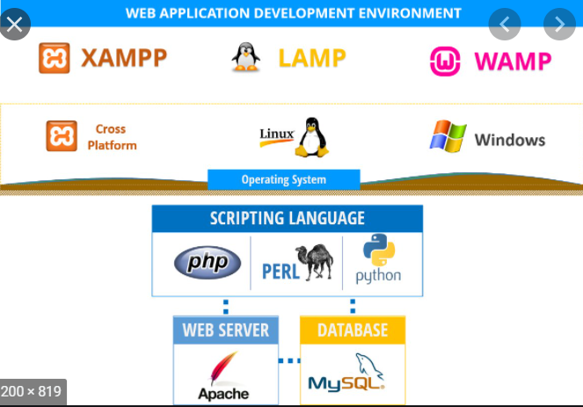

Install Xampp, MySql DB & Wordpress
Install Xampp web server in local host with MySQL db
Download latest version of WordPress
Install Wordpress under local web directory

Slide 6





What is CMS?
A content management system, often abbreviated as CMS, is software that helps users to create, manage, and modify content on a website without the need for specialized technical knowledge.
Similar Content Management tools are
Joomla
Drupal
Magento
Wix
TYPO3

Slide 7
Advantages of WordPress over other CMS
Ease of Use
Responsive Web Design (Fits with mobile & laptop layouts)
Easy Upgradation of Your Site
WooCommerce Implementation
Speed performance
Search Engine Optimisation
Security At its Best
Best in Class Social media Integration
Excellent Community Support
Regular Updates

Slide 8
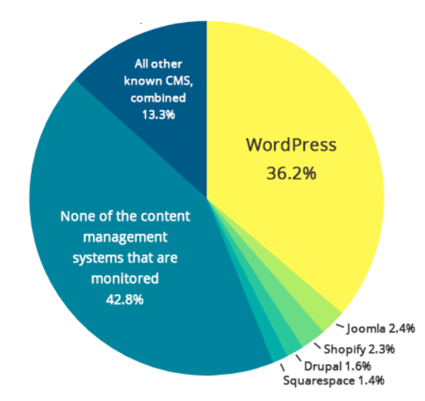
What is WordPress?
WordPress is the simplest, most popular way to create your own website or blog. In fact, WordPress powers over 30 to 40.0% of all the websites on the Internet.
Yes – more than one in five websites that
you visit are likely powered by WordPress.
Its free & open source website creation platform.
Written using PHP & MySQL.

Slide 9
Type of websites you can create using WordPress
Blog
E-commerce website
Business website
Membership website
Portfolio website(art & design)
Forum website(Discussion pool)
Event website
E-learning website
Wedding website

Slide 10
Admin Dashboard
By appending /wp-admin login to admin
Default screen with widgets such as activity, quick draft, WordPress events and news, and at a glance
Various menu options in the sidebar

Slide 11
Blog post in WordPress
By appending /wp-admin login to admin
Default screen with widgets such as activity, quick draft, WordPress events and news, and at a glance
Various menu options in the sidebar

Slide 12
Categories in WordPress
Categories are to sort and group your blog posts into different sections
Allow visitors quickly know what topics your website is about and allows them to navigate your site faster
Default category is "Uncategorized"
Default category can change from "Settings » Writing screen".
Category can have multiple child categories.
Drag drop category to display under blog sidebar under "Appearance » Widgets".

Slide 13
Tags in WordPress
One of the way to categorize WordPress post
Each post can contain multiple tags
Visitors can click on a tag to find similar posts that have that same tag
tags are completely optional in WordPress

Slide 14
Media in WordPress
Used to upload images, audio, video, and other files
Two menus
Library - lists all the files in the media library
Add New - which allows users to upload files
There is an option for photo editing that allows you to crop, resize, and scale images

Slide 15
Pages in WordPress
Allows you to publish content onto your WordPress blog Two menus
Like posts, WordPress pages are another post type that comes pre-built
We usually add content that doesn’t need to be updated often to pages.
Pages represent static type content, like the “About Us” page, “TOCs”, “Contact us”, and “Write for us”.
Can create multiple child pages
Can select different template specific to this page
You can re order the page positions to display
Can enable disable comments on page

Slide 16
Difference between Posts & Pages
If you are creating a blog you can make use of a posts.
If you are creating a webpage for your business then you can use pages to categorize the webpage.
Posts are timely vs. Pages are timeless.
Posts are social vs. Pages are NOT.
Posts can be categorized vs. Pages are hierarchical.
Posts are included in RSS feed vs. Pages are not.
Pages have custom template feature vs. Posts do not.

Slide 17
Thank You
Koushik G
9740294141
koushikgraj@gmail.com

